Slide 1

Schema Refinement ERM to RM
CS3083-B Prof. Arfaoui

Slide 2
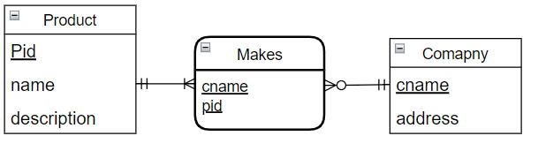
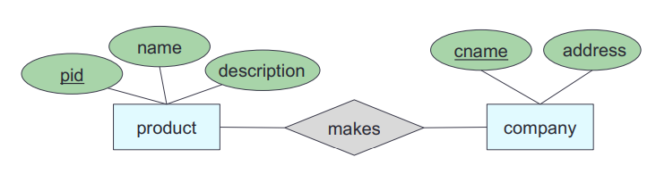
Translating from ERD to ERM (schema constraints)
There is a unique table which is assigned the name of the corresponding entity set or relationship set
product(pid, name, description)
company(cname, address)
makes(cname, pid)
Schema statement

Slide 3
Strong Entity Set
Direct map:
Entity name → relation name (table)
Attributes → columns
Primary key: same as entity
product(pid, name, description)
company(cname, address)
makes(@cname, @pid)

Slide 4
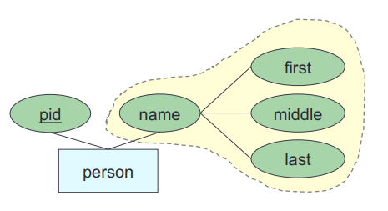
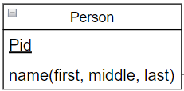
Strong Entity Set with composite attributes
Create separate attributes for each component
Don’t include the higher-level attribute
person(pid, first_name, middle_name, last_name)

Slide 5
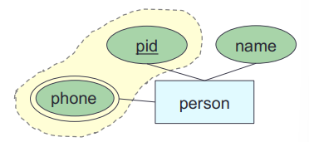
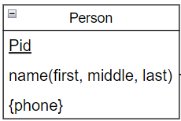
Strong Entity Set with Multivalued Attribute
Create a separate table for the multivalued attribute
Name the table with the concatenation, separated by “_”
entityname_attributename
Primary key: all attributes
person(pid, first_name, middle_name, last_name)
person_phone(@pid, phone_number)

Slide 6
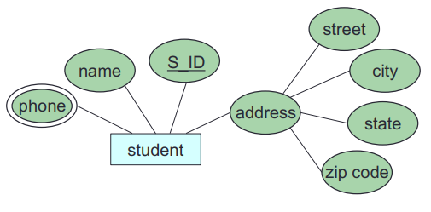
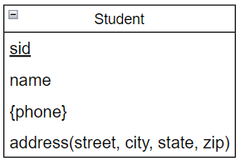
Let’s try: E-R-D to RM
Convert the following E-R diagram into relational schemas
student (sid, name, street_address, city_address, state_address, zip_address)
student_phone (@sid, phone)
PK of this table is a combination of all attributes

Slide 7
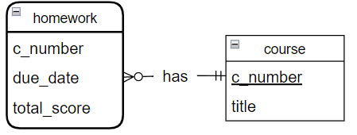
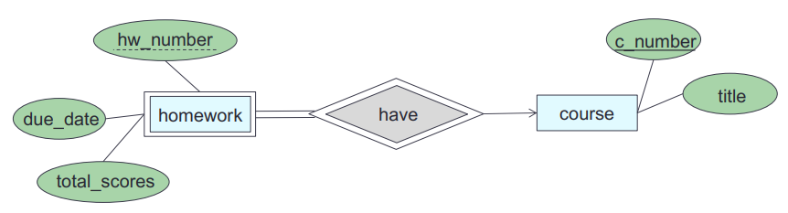
Weak Entity Set
Let A be a weak entity set and B be the identifying strong entity set on which A depends.
Create a table with primary key of B and all A’s attributes
Primary key: primary key of B (strong entity) and discriminator of A
course(c_number, title)
homework(@c_number, hw_number, due_date, total_scores)

Slide 8
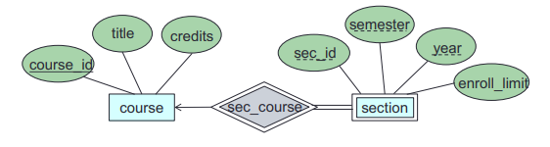
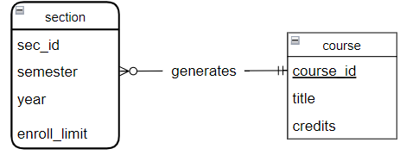
Let’s try: E-R-D to RM
Convert the following E-R diagram into relational schemas
course (course_id, title, credits)
section (@course_id, sec_id, semester, year, enroll_limit)

Slide 9
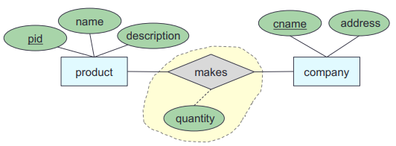
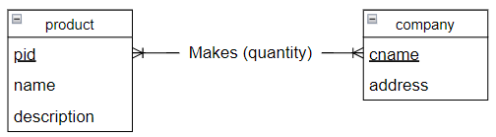
Relationship Set: Many-to-Many
Table: primary keys of both participating entity sets and any attributes on the relationship itself.
Primary key: primary keys of both participating entity sets
product(pid, name, description)
company(cname, address)
makes(@pid, @cname, quantity)
Primary keys of both entities

Slide 10
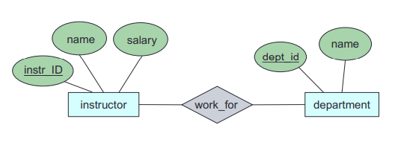
Let’s try: E-R-D to RM
Convert the following E-R diagram into relational schemas
instructor (instr_ID, name, salary)
department (dept_id, name)
work_for (@instr_ID, @dept_id)

Slide 11
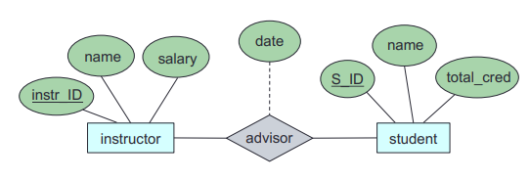
Let’s try: E-R-D to RM
Convert the following E-R diagram into relational schemas
instructor (instr_ID, name, salary)
student (S_ID, name, total_cred)
advisor (@instr_ID, @S_ID, date)

Slide 12
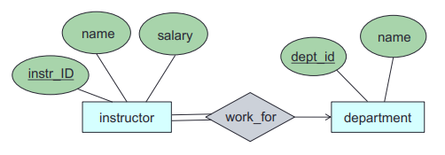
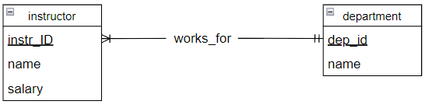
Relationship Set: Total Participation
Because the total participation requires all entity to be participated in the relationship.
add the primary key of the “one” side to the “many” side entity set, no table for relationship needed
instructor (instr_ID, name, salary, @dept_id)
department (dept_id, name)

Slide 13
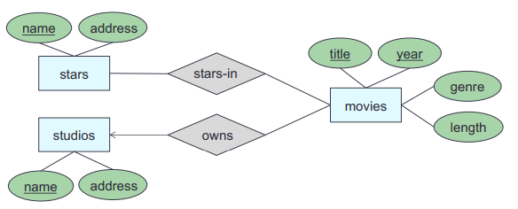
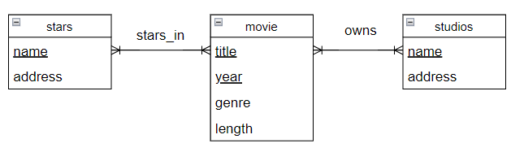
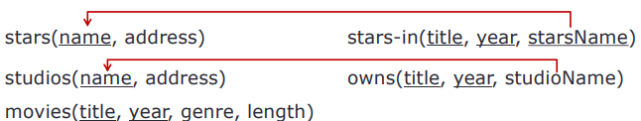
Let’s try: E-R-D to RM
Convert the following E-R diagram into relational schemas

Slide 14
Next Time:
Functional dependency Normalization

